Slide 1
Lecture 3: Gompertz model
April 12, 2018

Slide 2

Directed random walk
$$x_{t+1}=x_{t}+ε_{t}$$
$$ε_{t}\sim Normal(α,σ_{x}^{2})$$
$$log⁡(y_{t})\sim Normal(x_{t},σ_{y}^{2})$$
Time-series follows a random-walk with a trend $α$

Slide 3
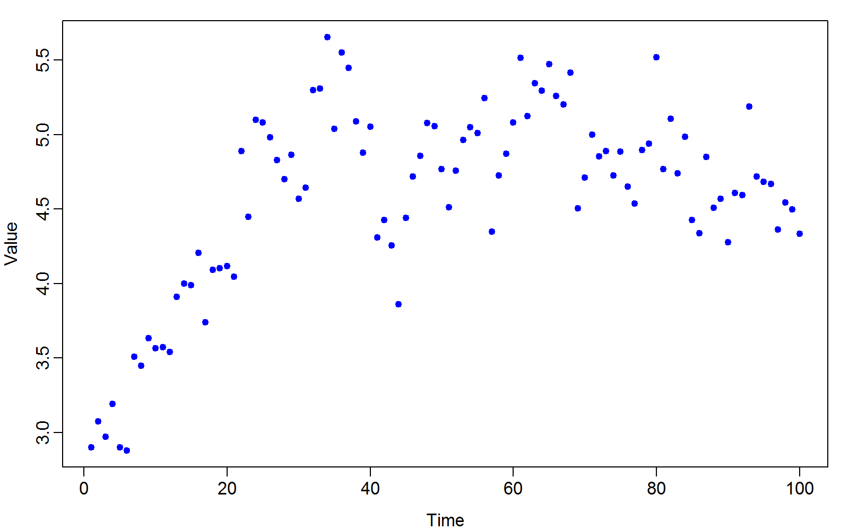
Data set

Slide 4
Questions
Is there evidence of density dependence?
If yes, what is the expected equilibrium?
What is the stationary distribution?
Variance
How “stable” is the model
Reactivitiy
Resilience
Resistence

Slide 5
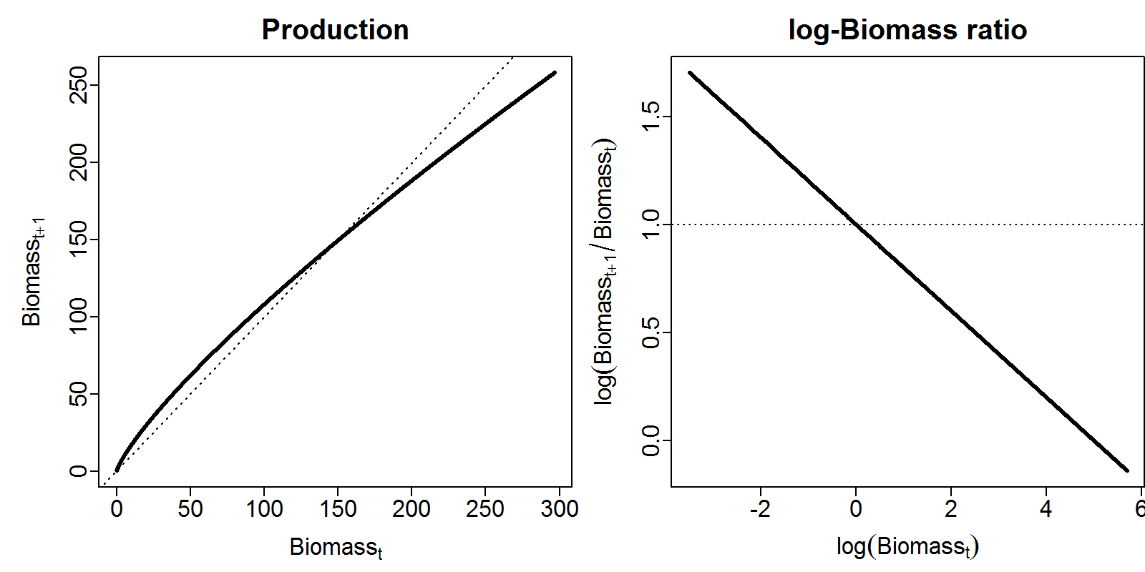

Gompertz model
$$d_{t+1}=d_{t}\exp\left(α−β{log⁡(d}_{t})+ε_{t}\right)$$
$$ε_{t}\sim Normal(0,σ_{d}^{2})$$
$$log⁡(b_{t})\sim Normal\left(log⁡(d_{t}),σ_{b}^{2}\right)$$

Slide 6
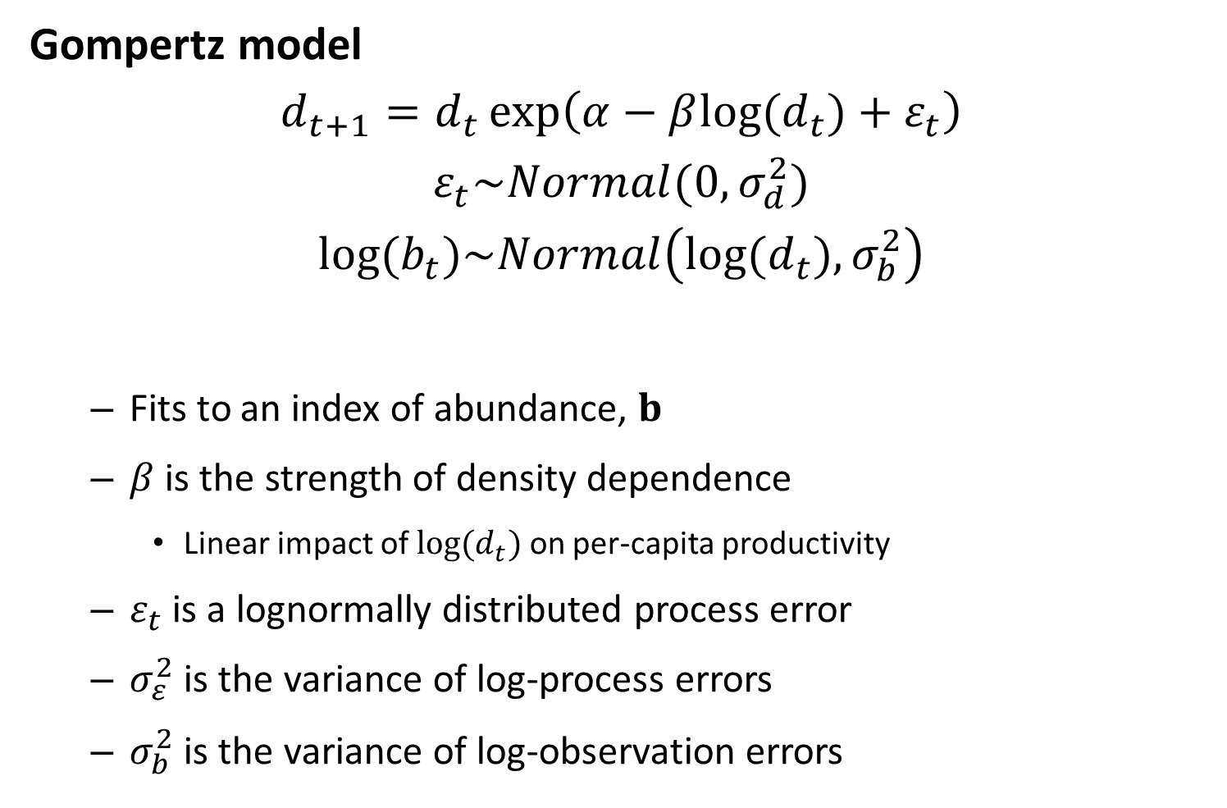
Gompertz model
$$d_{t+1}=d_{t}\exp\left(α−β{log⁡(d}_{t})+ε_{t}\right)$$
$$ε_{t}\sim Normal(0,σ_{d}^{2})$$
$$log⁡(b_{t})\sim Normal\left(log⁡(d_{t}),σ_{b}^{2}\right)$$
Fits to an index of abundance, $b$
$β$ is the strength of density dependence
Linear impact of ${log⁡(d}_{t})$ on per-capita productivity
$ε_{t}$ is a lognormally distributed process error
$σ_{ε}^{2}$ is the variance of log-process errors
$σ_{b}^{2}$ is the variance of log-observation errors

Slide 7
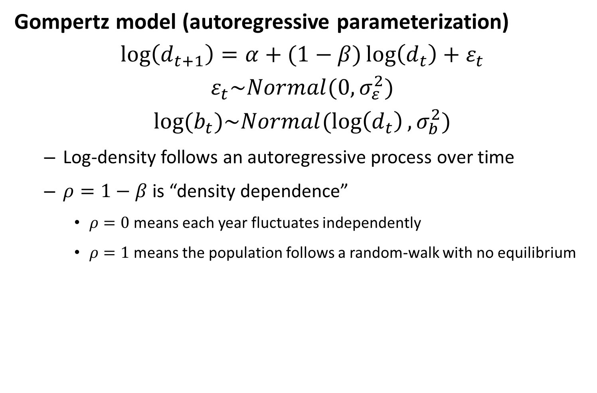
Gompertz model (autoregressive parameterization)
$$\log\left(d_{t+1}\right)=α+(1−β)\log\left(d_{t}\right)+ε_{t}$$
$$ε_{t}\sim Normal(0,σ_{ε}^{2})$$
$$log⁡(b_{t})\sim Normal(\log\left(d_{t}\right),σ_{b}^{2})$$
Log-density follows an autoregressive process over time
$ρ=1−β$ is “density dependence”
$ρ=0$ means each year fluctuates independently
$ρ=1$ means the population follows a random-walk with no equilibrium

Slide 8
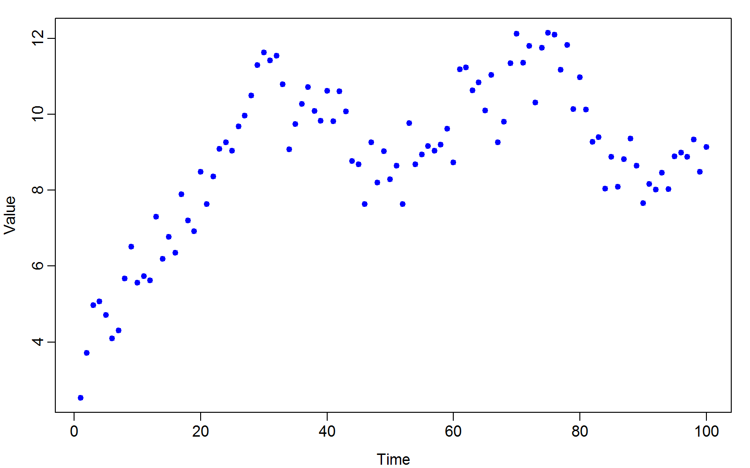
Gompertz model (autoregressive parameterization)

Slide 9
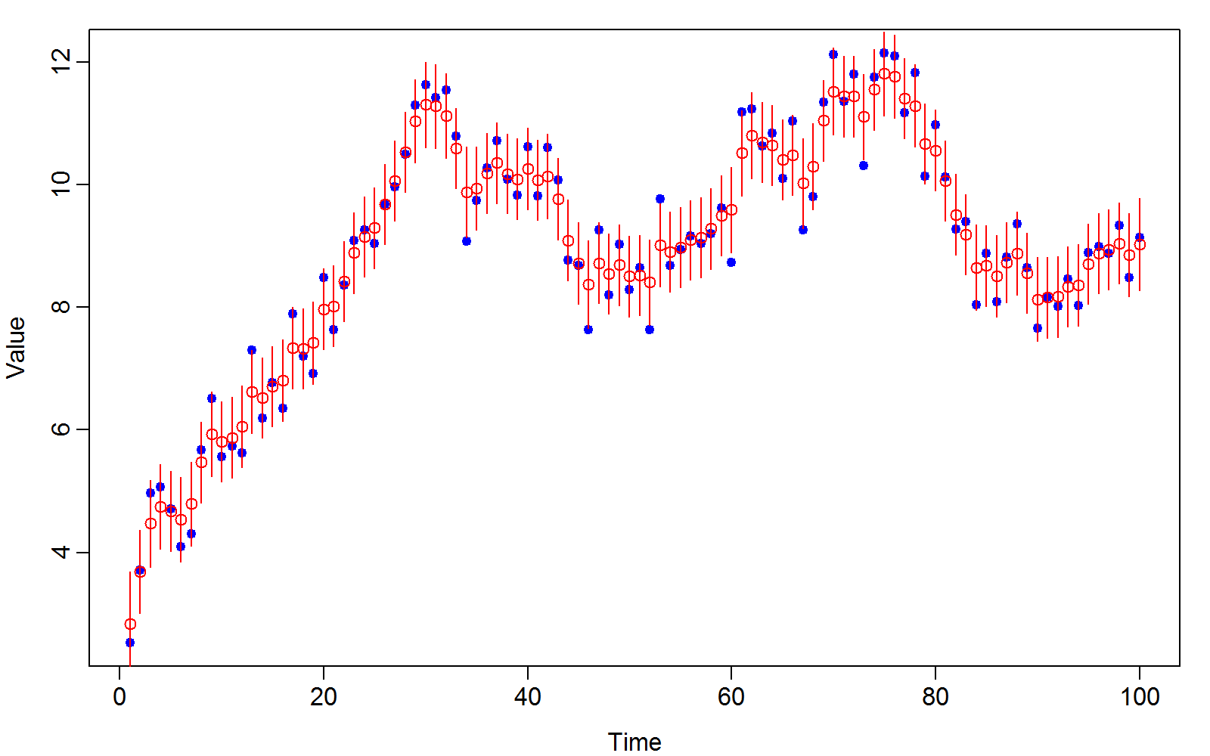
Gompertz model (autoregressive parameterization)

Slide 10
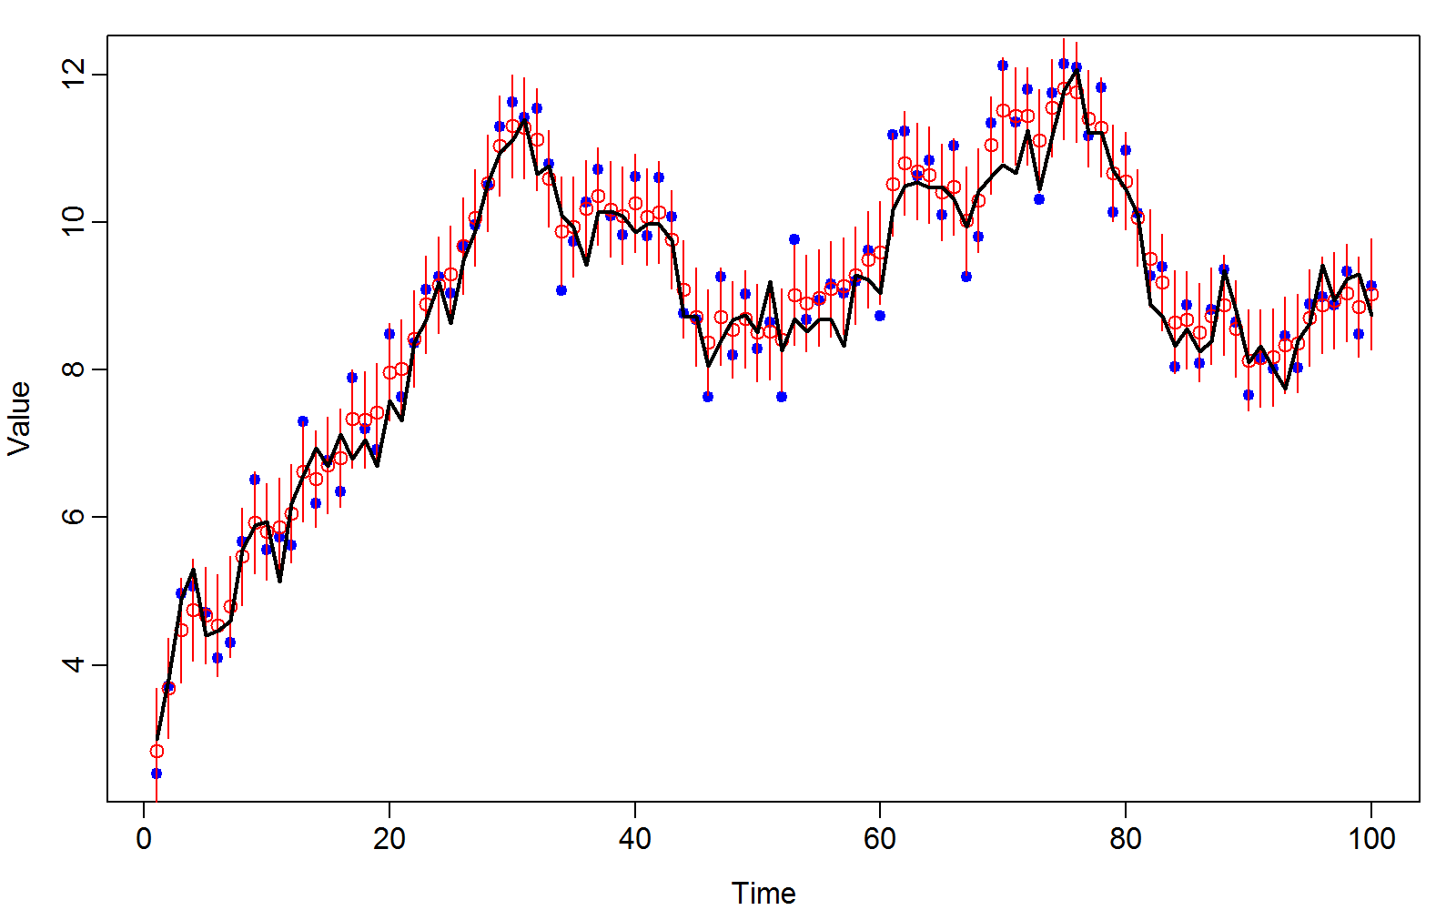
Gompertz model (autoregressive parameterization)

Slide 11
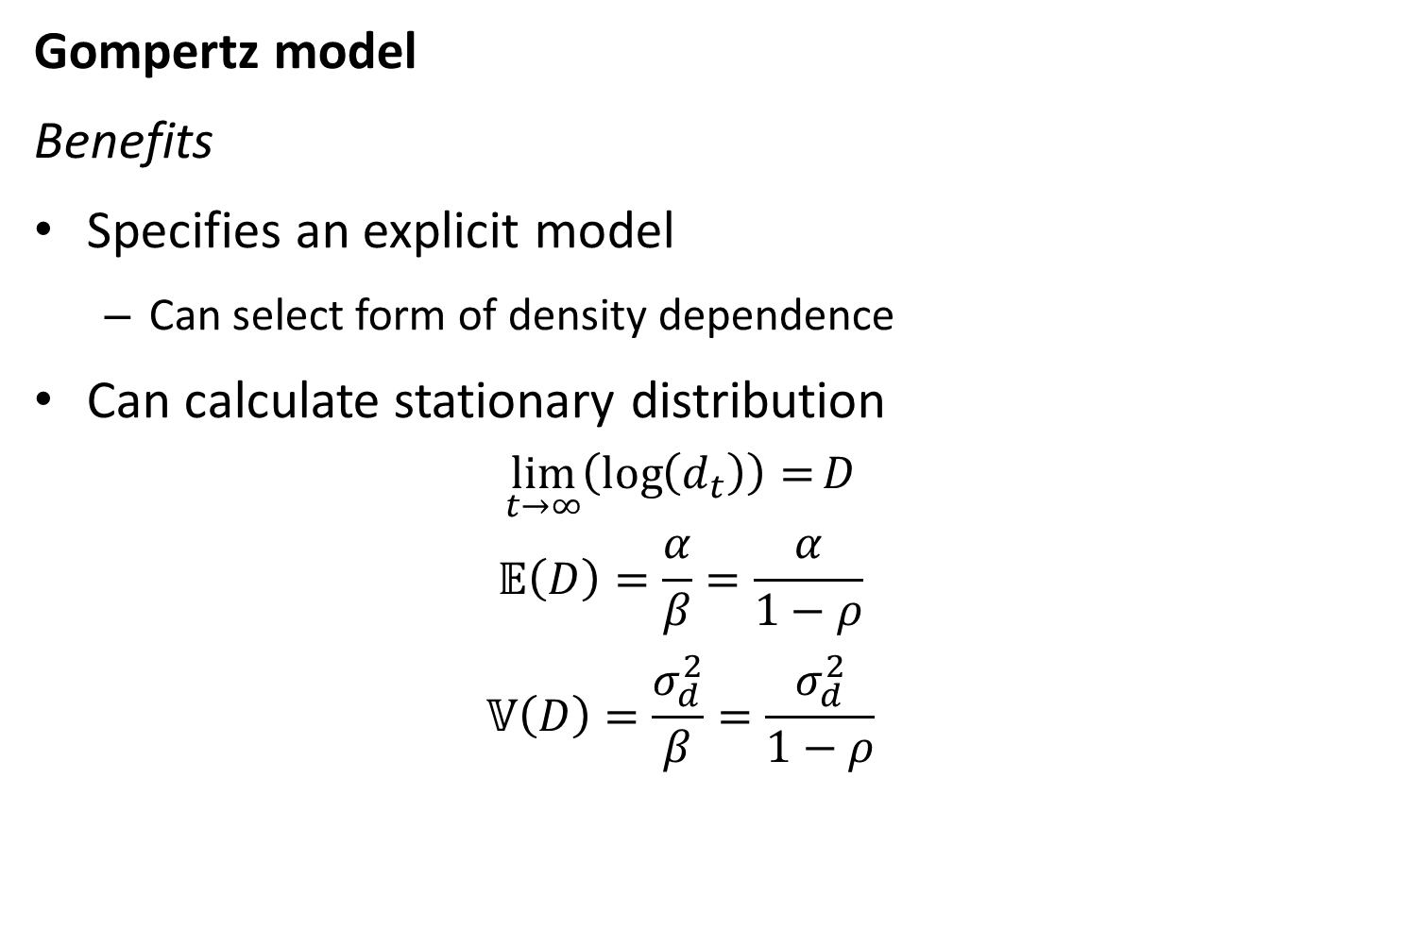
Gompertz model
Benefits
Specifies an explicit model
Can select form of density dependence
Can calculate stationary distribution
$$\lim_{t→∞}\left(\log\left(d_{t}\right)\right)=D$$
$$𝔼\left(D\right)=\frac{α}{β}=\frac{α}{1−ρ}$$
$$𝕍\left(D\right)=\frac{σ_{d}^{2}}{β}=\frac{σ_{d}^{2}}{1−ρ}$$

Slide 12
Map argument
[Look at map example in GitHub]

Slide 13
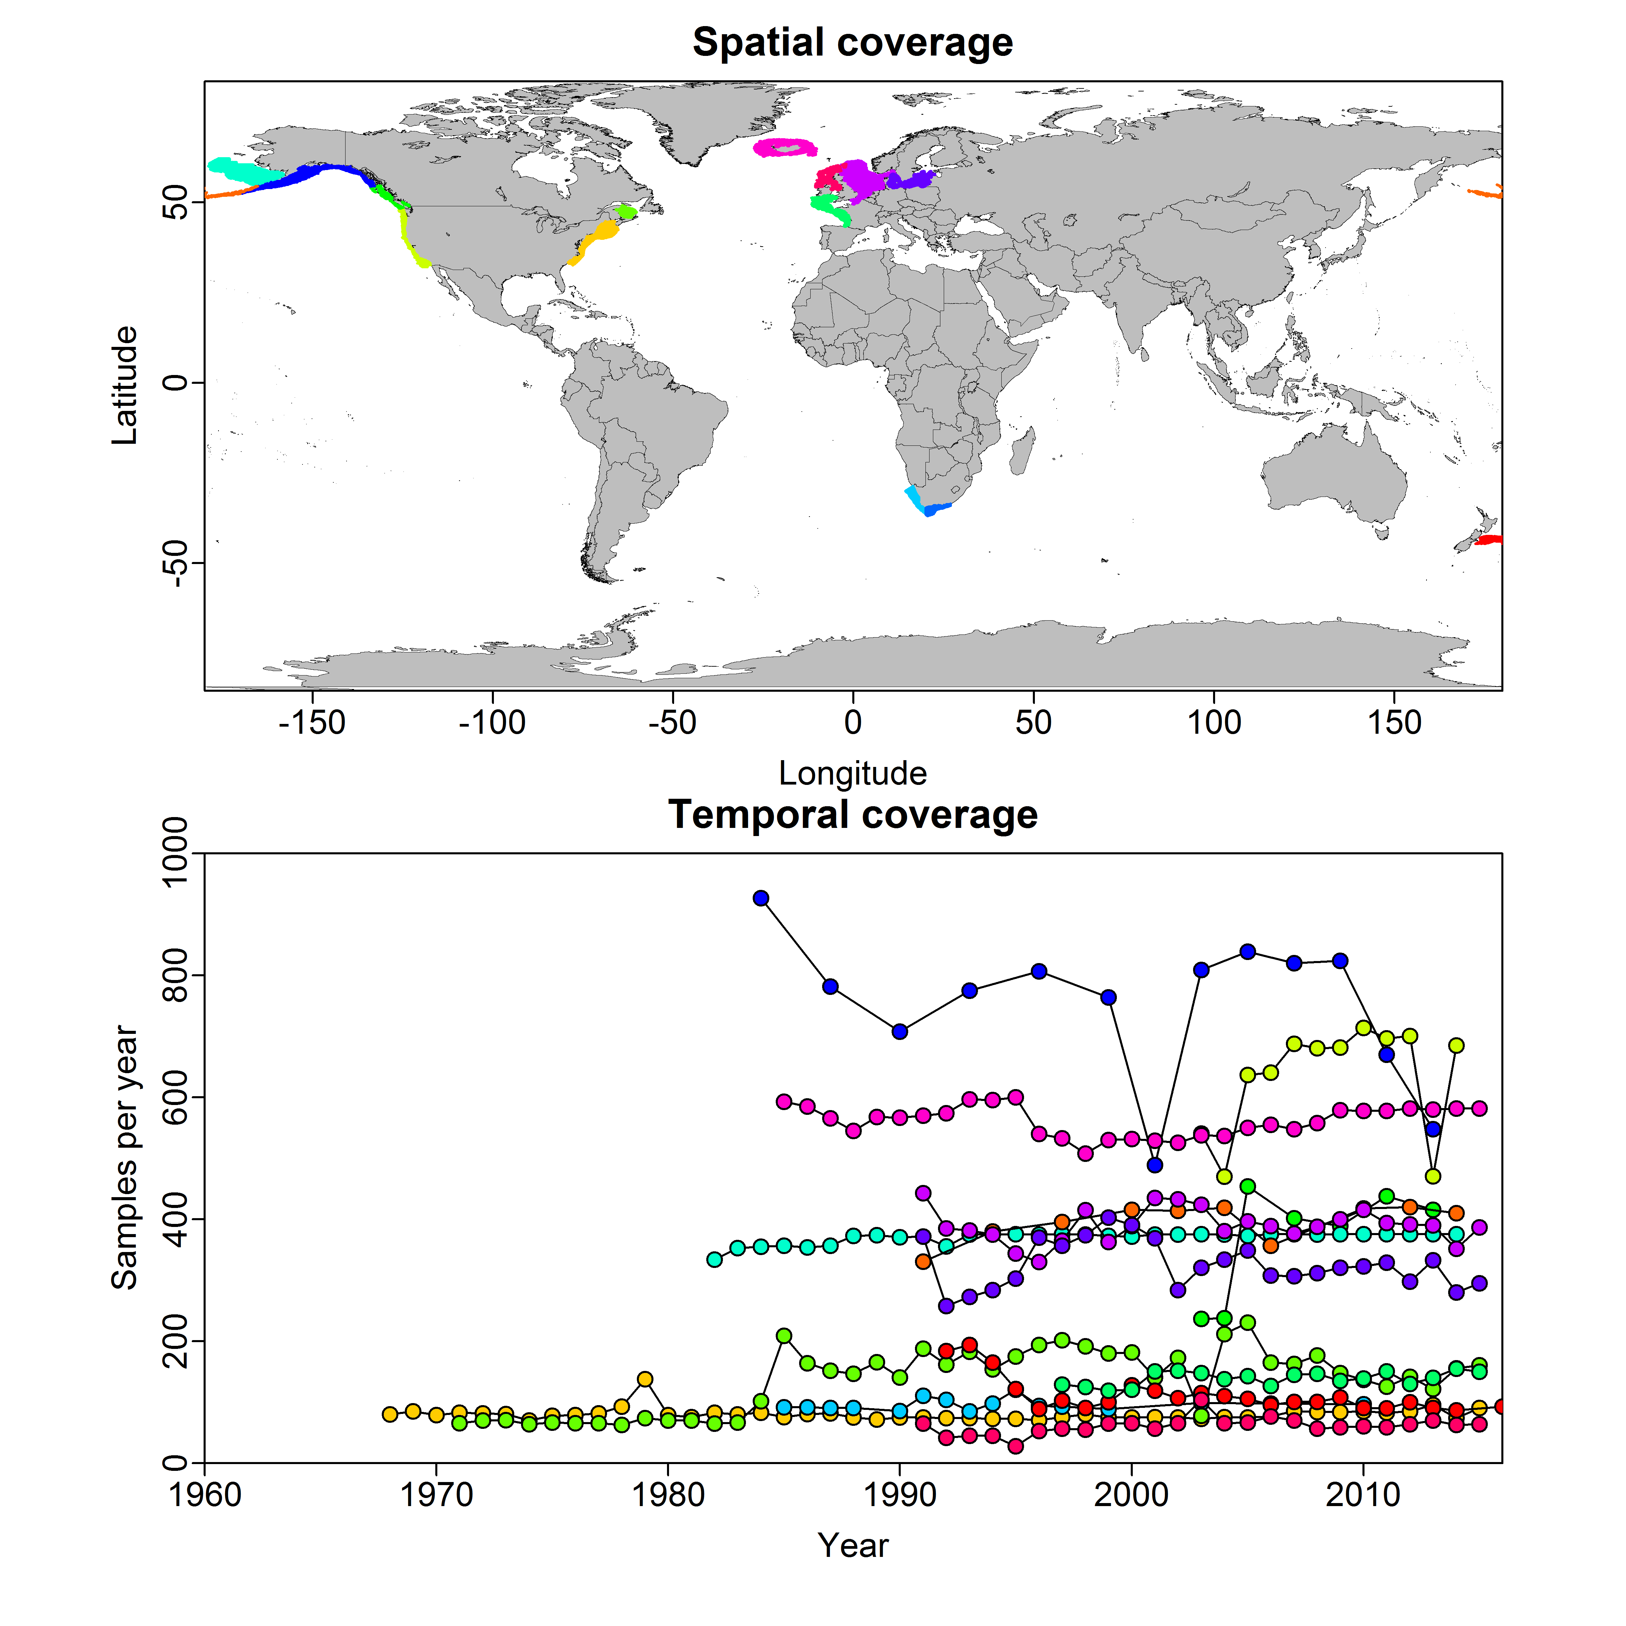
Try again with real data
Package FishData
Contains data for 100s of fish populations worldwide

Slide 14
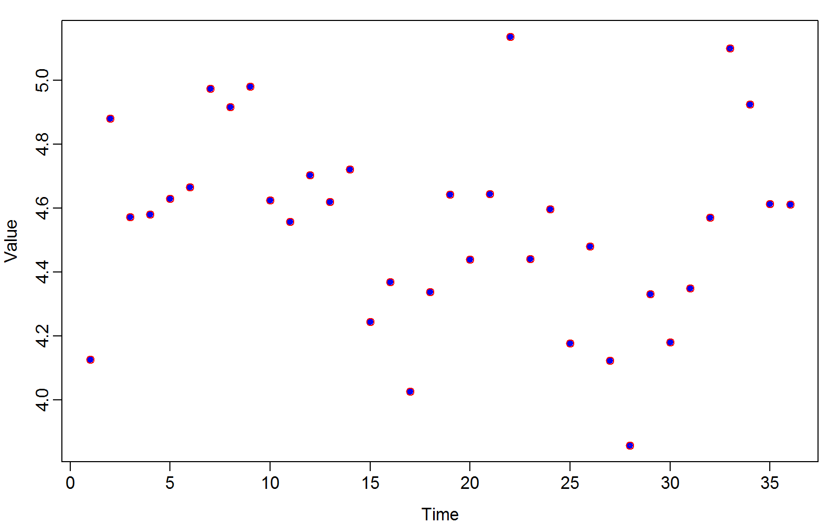
Alaska pollock
Is this converged?
How to modify?
Param | Starting value | Lower | MLE | Upper | Final gradient | Std. Error
log_d0 | 0 | -Inf | 4.126071 | Inf | 3.75E-07 | 0.260514
log_sigmaP | 1 | -Inf | -1.3451 | Inf | 3.34E-06 | 0.117851
log_sigmaM | 1 | -Inf | -11.029 | Inf | 7.42E-10 | 26029.84
alpha | 0 | -Inf | 2.651077 | Inf | -1.42E-06 | 0.665236
rho | 0 | -Inf | 0.419967 | Inf | -2.64E-06 | 0.145993

Slide 15
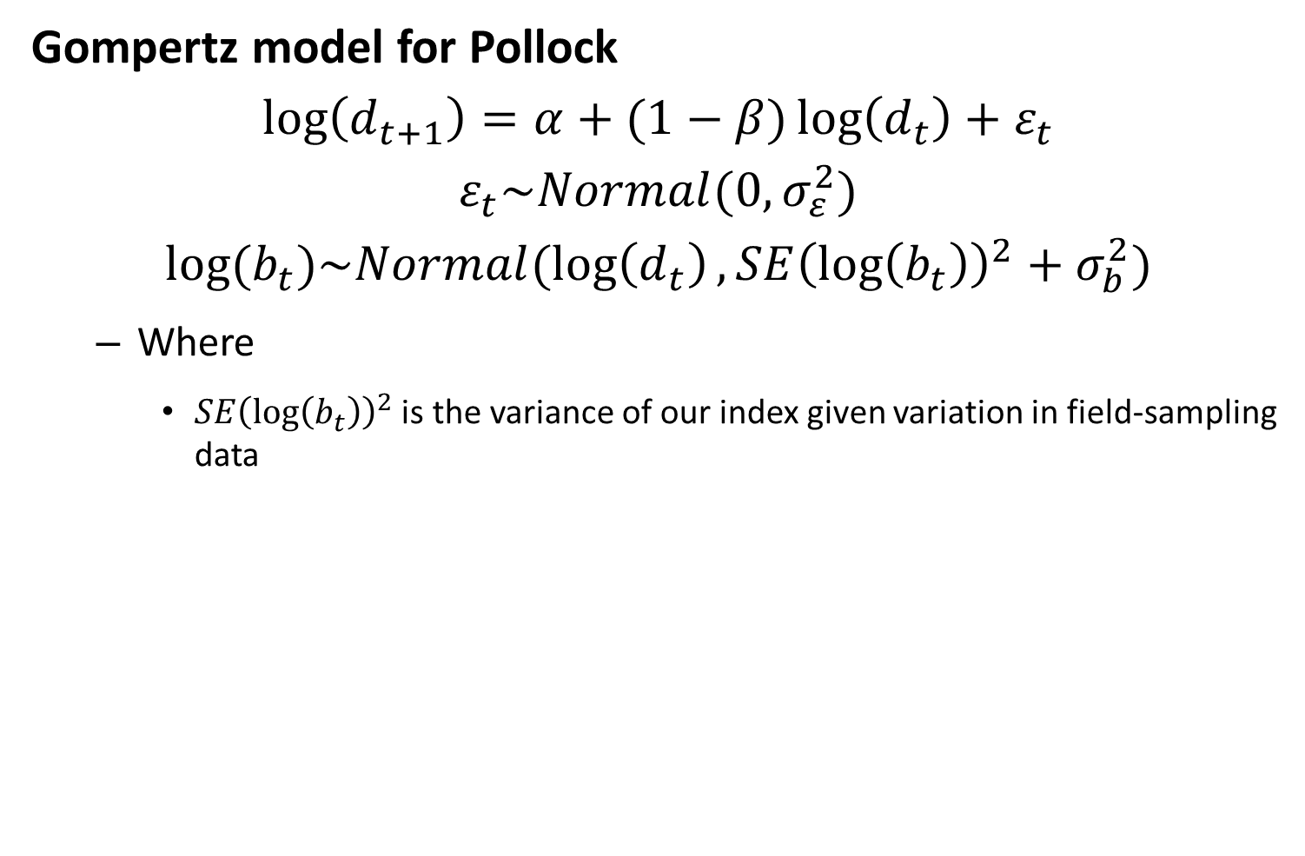
Gompertz model for Pollock
$$\log\left(d_{t+1}\right)=α+(1−β)\log\left(d_{t}\right)+ε_{t}$$
$$ε_{t}\sim Normal(0,σ_{ε}^{2})$$
$$log⁡(b_{t})\sim Normal(\log\left(d_{t}\right),SE{\left(\log\left(b_{t}\right)\right)}^{2}+σ_{b}^{2})$$
Where
$SE{\left(\log\left(b_{t}\right)\right)}^{2}$ is the variance of our index given variation in field-sampling data

Slide 16
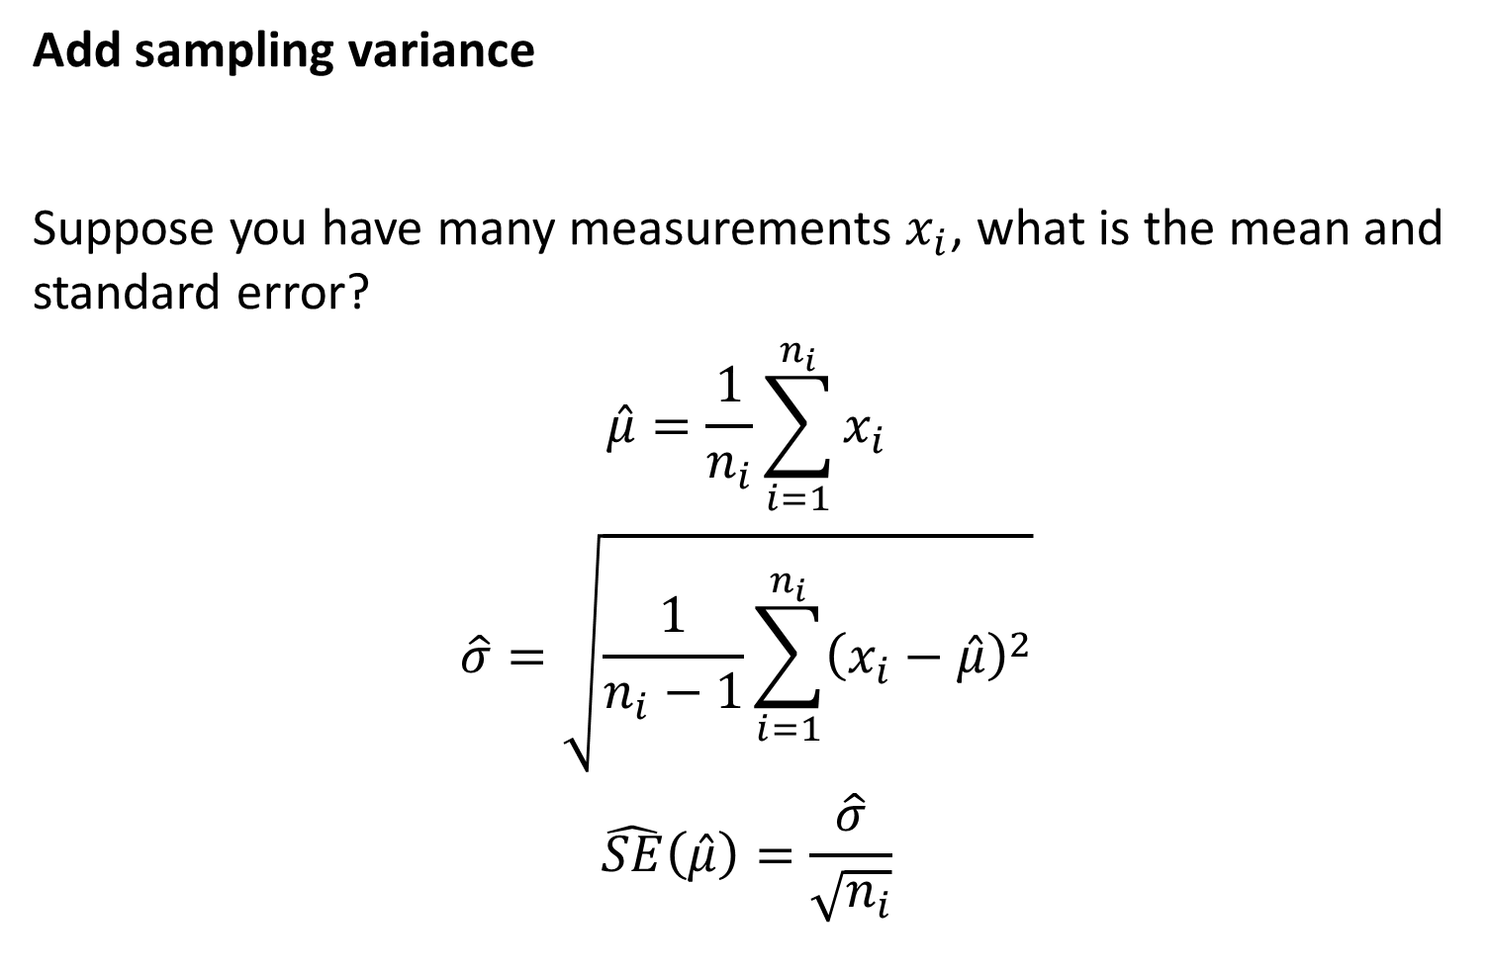
Add sampling variance
Suppose you have many measurements $x_{i}$, what is the mean and standard error?
$$\hat{μ}=\frac{1}{n_{i}}\sum_{i=1}^{n_{i}}{x_{i}}$$
$$\hat{σ}=\sqrt{\frac{1}{n_{i}−1}\sum_{i=1}^{n_{i}}{{\left(x_{i}−\hat{μ}\right)}^{2}}}$$
$$\hat{SE}\left(\hat{μ}\right)=\frac{\hat{σ}}{\sqrt{n_{i}}}$$

Slide 17
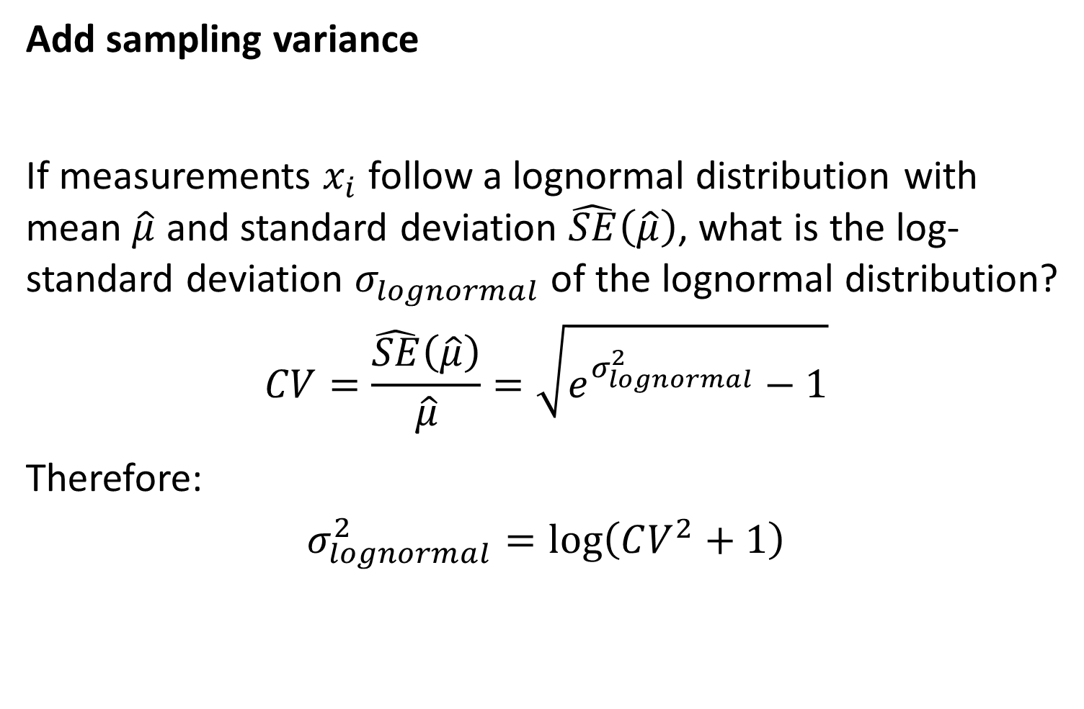
Add sampling variance
If measurements $x_{i}$ follow a lognormal distribution with mean $\hat{μ}$ and standard deviation $\hat{SE}\left(\hat{μ}\right)$, what is the log-standard deviation $σ_{lognormal}$ of the lognormal distribution?
$$CV=\frac{\hat{SE}\left(\hat{μ}\right)}{\hat{μ}}=\sqrt{e^{σ_{lognormal}^{2}}−1}$$
Therefore:
$$σ_{lognormal}^{2}=\log\left(CV^{2}+1\right)$$

Slide 18
Lab exercise
[Add sampling variance and re-run]

Slide 19
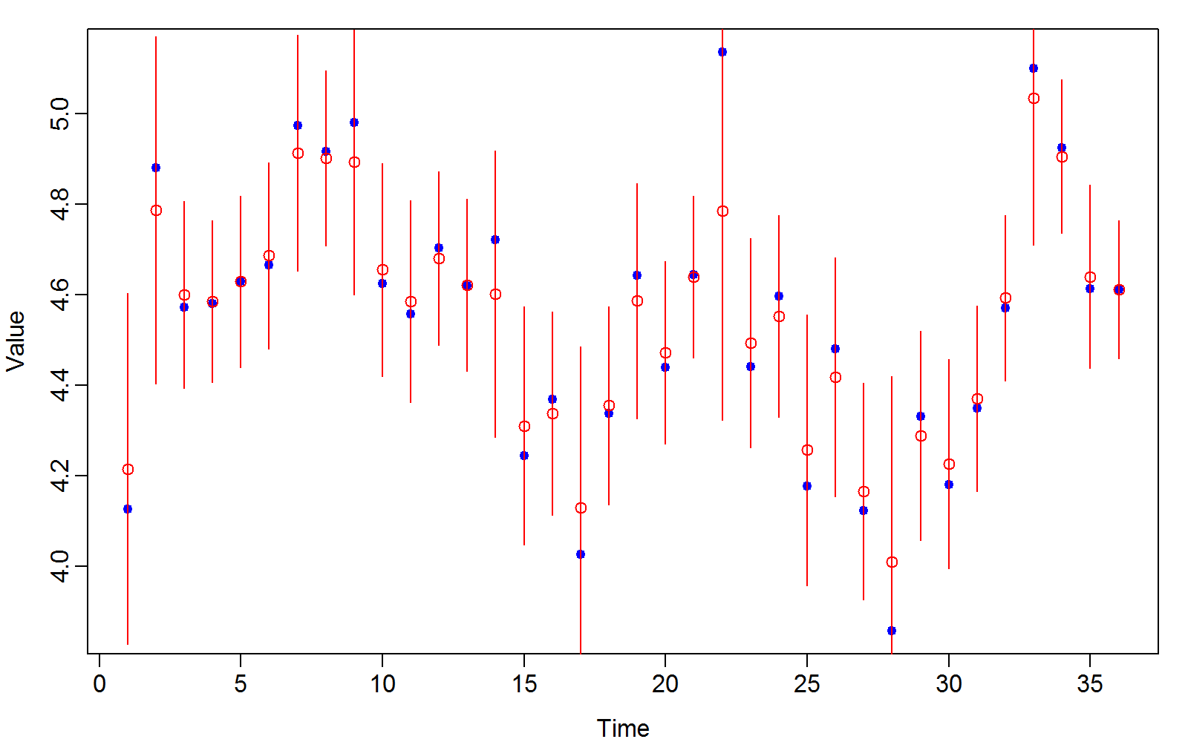
Alaska pollock
Is this converged?
How to modify?
Param | Starting value | Lower | MLE | Upper | Final gradient | Std. Error
log_d0 | 0 | -Inf | 4.21494 | Inf | 2.35E-07 | 0.290923
log_sigmaP | 1 | -Inf | -1.54627 | Inf | -1.26E-07 | 0.297971
log_sigmaM | 1 | -Inf | -4.98037 | Inf | -4.42E-09 | 13.00587
alpha | 0 | -Inf | 2.071196 | Inf | 3.71E-06 | 1.02898
rho | 0 | -Inf | 0.546332 | Inf | 1.67E-05 | 0.225704

Slide 20
Lab exercise
[Fix SigmaM at 0 and re-run]

